Slide 1

GUI Layout
Pack
Place
Grid
Frames
Notes:
Now that we have our widgets we need to place in the right place on our GUI.
In this lesson we’ll learn how to use the Tkinter layout managers in a FRAME:
we’ll look at PACK, PLACE, and GRID.
And we’ll see how to nest multiple frames, with separate layout managers, to build complex GUI.

Slide 2
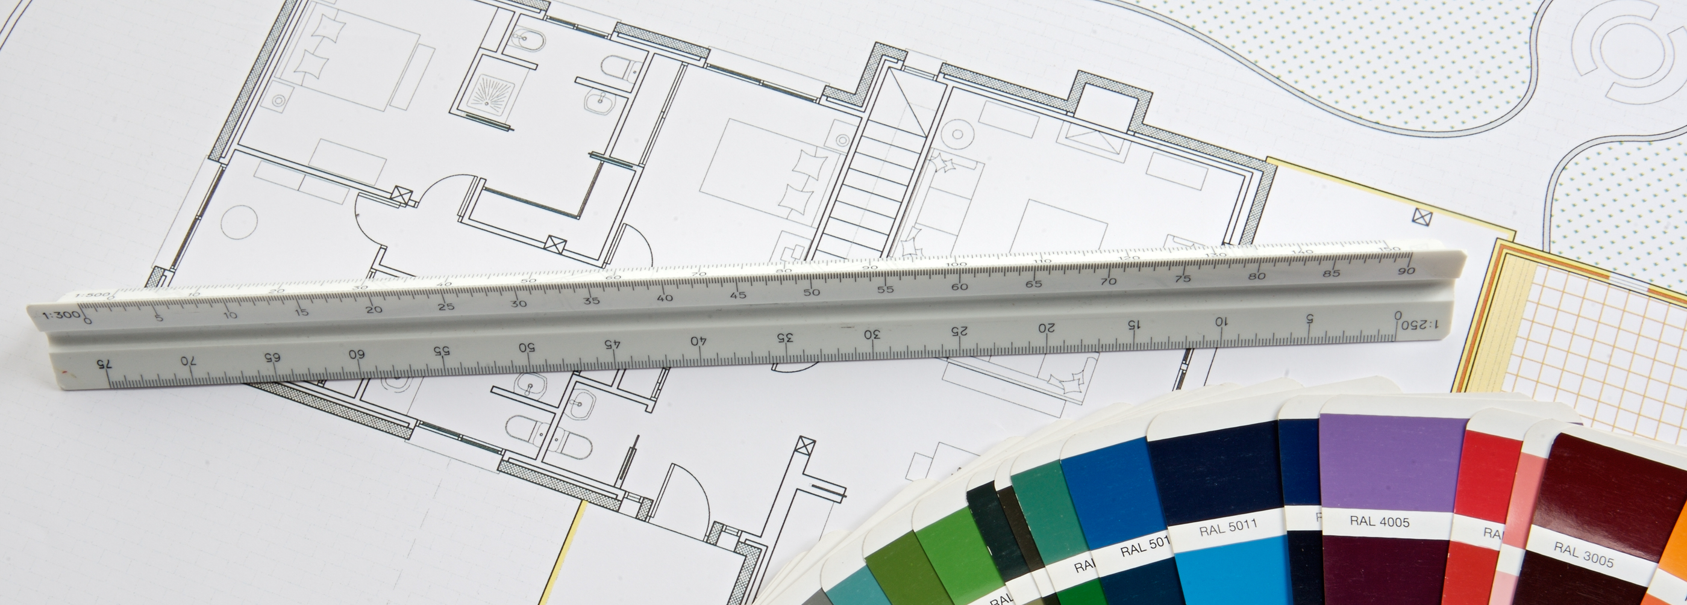
See Also
http://effbot.org/tkinterbook/pack.htm
https://www.python-course.eu/tkinter_layout_management.php
https://stackoverflow.com/questions/34276663/tkinter-gui-layout-using-frames-and-grid
Notes:
Here is some additional reading on the web.

Slide 3
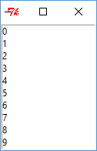
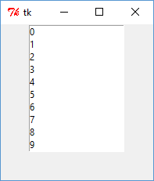
Pack (defaults)
import tkinter
top = tkinter.Tk()
listbox = tkinter.Listbox(top)
for i in range(20):
listbox.insert(Tkinter.END, str(i))
listbox.pack()
top.mainloop()
Streams of bytes … two ways (into your program and out of your program)
Disks, consoles, sockets, keyboards, printers
Know how to talk streams and you can talk to anything
Initialization (constructor) is different. Use is the same.
Notes:
We’ve already seen PACK. This layout manager packs the components together in a frame -- one after the other. The default behavior, if you don’t pass any parameters to PACK, is to add them one after the other on separate ROWS starting at the top of the FRAME.
@1 Here’s a widget we haven’t used yet … the listbox. It’s just a simple list of items.
@2 Let’s add 20 items to the list ... Numbered 0 through 19.
The listbox is keeping its own storage. We tell it to insert … on the END … a new entry by turning our counter into a string.
@3 Then we pack the listbox into the frame. The default is to pack it in the top of the frame and not to expand it at all when more space is available.
@4 This is more obvious when we expand the panel. The widget’s size never changes, and it stays anchored to the top and in the middle of its row.
Note that the default size of the listbox widget only shows 10 rows at a time. There’s probably a parameter or two we can pass in here to change that.

Slide 4
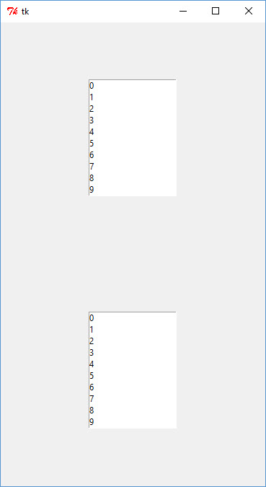
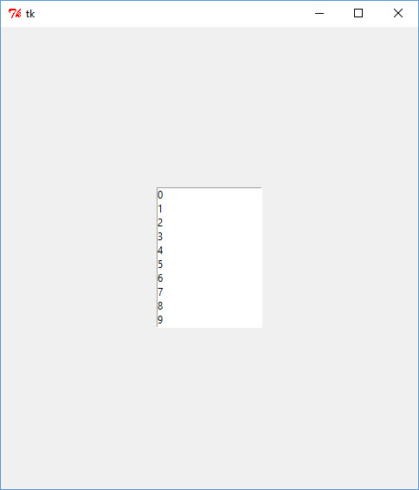
Pack (expand)
import tkinter
top = tkinter.Tk()
listbox = tkinter.Listbox(top)
for i in range(20):
listbox.insert(tkinter.END, str(i))
listbox.pack(expand=1)
top.mainloop()
Streams of bytes … two ways (into your program and out of your program)
Disks, consoles, sockets, keyboards, printers
Know how to talk streams and you can talk to anything
Initialization (constructor) is different. Use is the same.
Notes:
@1 The “expand” argument tells PACK that the row created for this widget should expand to take up any extra space.
@2 The widget is centered in its row vertically and horizontally and stays there as you change the window.
@3 If we add another component … say another list box … and set it to expand=1 then the frame splits the remaining space evenly between the two.
@4 Here is the first row
@5 And here is the second
You can have as many rows with expand=1 as you want. The frame divides the extra space evenly among them all.

Slide 5
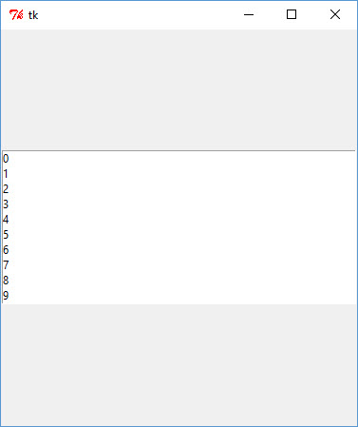
Pack (fill)
import tkinter
top = tkinter.Tk()
listbox = tkinter.Listbox(top)
for i in range(20):
listbox.insert(tkinter.END, str(i))
listbox.pack(fill=tkinter.X, expand=1)
top.mainloop()
Streams of bytes … two ways (into your program and out of your program)
Disks, consoles, sockets, keyboards, printers
Know how to talk streams and you can talk to anything
Initialization (constructor) is different. Use is the same.
Notes:
@1 The “fill” attribute tells PACK to resize the widget to fill its row.
Here we only fill along the X axis … horizontally … not vertically. As we stretch the window the widget remains centered in its row, but it grows side to side.

Slide 6
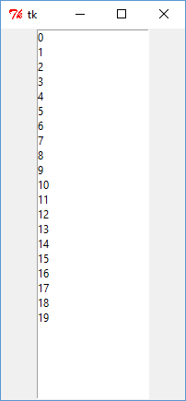
Pack (fill and expand)
import tkinter
top = tkinter.Tk()
listbox = tkinter.Listbox(top)
for i in range(20):
listbox.insert(tkinter.END, str(i))
listbox.pack(fill=tkinter.Y, expand=1)
top.mainloop()
Streams of bytes … two ways (into your program and out of your program)
Disks, consoles, sockets, keyboards, printers
Know how to talk streams and you can talk to anything
Initialization (constructor) is different. Use is the same.
Notes:
@1 It makes more sense to fill along the Y axis.
@2 Now the widget grows vertically … but not horizontally.

Slide 7
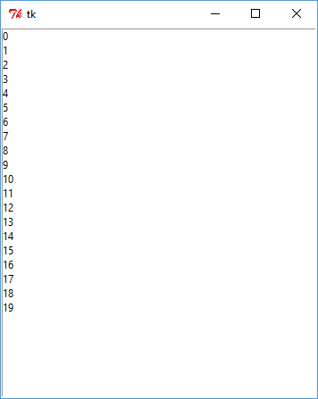
Pack (fill and expand)
import tkinter
top = tkinter.Tk()
listbox = tkinter.Listbox(top)
for i in range(20):
listbox.insert(tkinter.END, str(i))
listbox.pack(fill=tkinter.BOTH, expand=1)
top.mainloop()
Streams of bytes … two ways (into your program and out of your program)
Disks, consoles, sockets, keyboards, printers
Know how to talk streams and you can talk to anything
Initialization (constructor) is different. Use is the same.
Notes:
@1 And, if you want, you can make the component grow in BOTH directions.

Slide 8
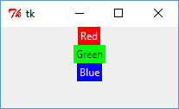
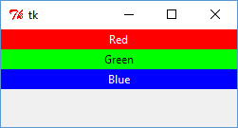
Pack (rows)
w = tkinter.Label(top, text="Red", bg="red", fg="white")
w.pack()
w = tkinter.Label(top, text="Green", bg="green", fg="black")
w.pack()
w = tkinter.Label(top, text="Blue", bg="blue", fg="white")
w.pack()
w = tkinter.Label(top, text="Red", bg="red", fg="white")
w.pack(fill=tkinter.X)
w = tkinter.Label(top, text="Green", bg="green", fg="black")
w.pack(fill=tkinter.X)
w = tkinter.Label(top, text="Blue", bg="blue", fg="white")
w.pack(fill=tkinter.X)
Streams of bytes … two ways (into your program and out of your program)
Disks, consoles, sockets, keyboards, printers
Know how to talk streams and you can talk to anything
Initialization (constructor) is different. Use is the same.
Notes:
We’ve seen the default packing strategy is ROWS.
@1 Here is a label … background red, foreground white. Packed by default on a row from top down.
@2 Another label. Background green.
@3 And a third one BLUE
@4 Let’s try those again
@5 But this time they fill along the x-axis
@6 Looks like this. None of them are expanded – the extra space builds up on the bottom.
That’s ROWS

Slide 9
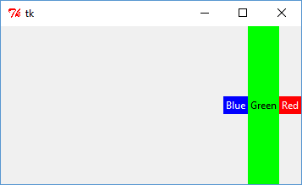
Pack (columns)
w = tkinter.Label(top, text="Red", bg="red", fg="white")
w.pack()
w = tkinter.Label(top, text="Green", bg="green", fg="black")
w.pack()
w = tkinter.Label(top, text="Blue", bg="blue", fg="white")
w.pack()
w = tkinter.Label(top, text="Red", bg="red", fg="white")
w.pack(side=tkinter.RIGHT)
w = tkinter.Label(top, text="Green", bg="green", fg="black")
w.pack(side=tkinter.RIGHT,fill=tkinter.Y)
w = tkinter.Label(top, text="Blue", bg="blue", fg="white")
w.pack(side=tkinter.RIGHT)
Streams of bytes … two ways (into your program and out of your program)
Disks, consoles, sockets, keyboards, printers
Know how to talk streams and you can talk to anything
Initialization (constructor) is different. Use is the same.
Notes:
@1 You can also pack in columns starting on the RIGHT, as we did here, or on the LEFT. You pass in a SIDE argument.
How did I do this green button filling up the entire column?
@2 Same way… pack to the right. But fill the Y axis – vertically.
@3 And the blue label after that

Slide 10
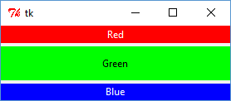
Pack (padding)
w = tkinter.Label(top, text="Red", bg="red", fg="white")
w.pack(fill=tkinter.X)
w = tkinter.Label(top, text="Green", bg="green", fg="black")
w.pack(fill=tkinter.X, ipadx=5, ipady=10, pady=4)
w = tkinter.Label(top, text="Blue", bg="blue", fg="white")
w.pack(fill=tkinter.X)
Streams of bytes … two ways (into your program and out of your program)
Disks, consoles, sockets, keyboards, printers
Know how to talk streams and you can talk to anything
Initialization (constructor) is different. Use is the same.
Notes:
You can specify padding when you pack a widget. Padding is space around the edge of the widget.
@1 Here is that green label
@2 And we call pack with padding
There are two kinds of padding … inside and outside the widget.
@3 PAD without the I is padding outside the widget. PAD Y is padding along the Y axis. This is how we got the 4 pixel space above and below the label.
@4 IPAD is internal padding. See how the green label is taller than the others? That’s because we added 10 pixel along the Y axis … above and below the text, but INSIDE the component – within its background.
@5 We added 5 pixels on the left and right of the component … inside the component. But since the component is filling side to side, it doesn’t show up. If these were in columns then you would notice. And if you changed it to PAD X … outer padding … you would see 5 pixel bands on the sides here and here.

Slide 11
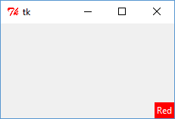
Pack (anchor)
w = tkinter.Label(top, text="Red", bg="red", fg="white")
w.pack(anchor=tkinter.SE, expand=1)
NW
N
NE
W
CENTER
E
SW
S
SE
Notes:
The default is for the component to occupy the exact center of its row (or column).
You can change this with the ANCHOR argument.
@1 Here we expand the widget’s row to take in the extra space. But instead of anchoring it to the center of its are, we pick the SOUTH EAST.
@2 Here is the south east … bottom right
@3 You can pick SOUTH, SOUTHWEST, WEST, NORTHWEST, NORTH, NORTHEAST, EAST, or CENTER – the default if you don’t specify one.

Slide 12
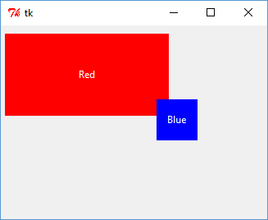
Place
w = tkinter.Label(top, text="Red", bg="red", fg="white")
w.place(x=5,y=10,width=200,height=100)
w = tkinter.Label(top, text="Blue", bg="blue", fg="white")
w.place(x=190,y=90,width=50,height=50)
Streams of bytes … two ways (into your program and out of your program)
Disks, consoles, sockets, keyboards, printers
Know how to talk streams and you can talk to anything
Initialization (constructor) is different. Use is the same.
Notes:
That’s the PACK layout manager.
If you want full control over widget placement and size you can use the PLACE layout manager.
@1 Instead of calling PACK, you call PLACE. And you pass in the X,Y position … this is the components upper left corner … in pixels. And you pass in the width and height … again in pixels.
@2 If the components overlap then the last ones added are drawn on top of the earlier ones.

Slide 13
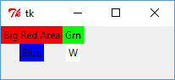
Grid
w = tkinter.Label(top, text="Big Red Area", bg="red")
w.grid(row=0,column=0)
w = tkinter.Label(top, text="Grn", bg="green")
w.grid(row=0,column=1)
w = tkinter.Label(top, text="Blue", bg="blue")
w.grid(row=1,column=0)
w = tkinter.Label(top, text="W", bg="white")
w.grid(row=1,column=1)
rowspan
colspan
sticky (N+E+S+W)
Streams of bytes … two ways (into your program and out of your program)
Disks, consoles, sockets, keyboards, printers
Know how to talk streams and you can talk to anything
Initialization (constructor) is different. Use is the same.
Notes:
Another layout manager is GRID. It divides the frame up into a number of columns and rows. All of the cells in a column have the same width. The width of big red is the same width as blue.
The layout manager automatically sizes the areas once all the widgets are added.
@1 Here is big red … row 0 column 0
@2 Here is green … row 0 column 1
@3 blue … row 1 column 0
@4 and white … row 1 column 1
Widgets can span multiple rows and/or multiple columns
@5 Use the rowspan argument to set the number of rows the widget covers
@5 And colspan to set the number of columns
You can use both at the same time
By default, the widgets are placed in the center of their area. That’s why BLUE here, is in the middle.
@6 But you can use the STICKY argument to change the position to NORTH, EAST, SOUTH, or WEST.
If we had given Blue sticky equals EAST, for instance, then the widget be over here at the right edge of the column.

Slide 14
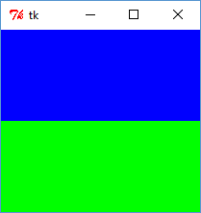
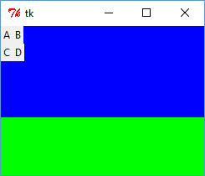
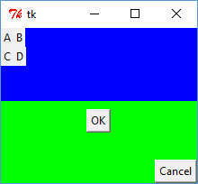
Frames
root = tkinter.Tk()
top = tkinter.Frame(root,bg="blue")
bottom = tkinter.Frame(root,bg="green")
top.pack(expand=1,fill=tkinter.BOTH)
bottom.pack(expand=1,fill=tkinter.BOTH)
m1 = tkinter.Label(top,text="A");
m2 = tkinter.Label(top,text="B");
m3 = tkinter.Label(top,text="C");
m4 = tkinter.Label(top,text="D");
m1.grid(row=0,column=0)
m2.grid(row=0,column=1)
m3.grid(row=1,column=0)
m4.grid(row=1,column=1)
b1 = tkinter.Button(bottom,text="OK")
b2 = tkinter.Button(bottom,text="Cancel")
b1.pack(anchor=tkinter.CENTER,expand=1)
b2.pack(anchor=tkinter.SE,expand=1)
Streams of bytes … two ways (into your program and out of your program)
Disks, consoles, sockets, keyboards, printers
Know how to talk streams and you can talk to anything
Initialization (constructor) is different. Use is the same.
Notes:
Most of your REAL GUIs will be built from several nested frames … each with its own layout manager.
@1 for instance, let’s make two frames … a blue one at the top
@2 and a green one on the bottom
@3 We’ll pack them both on rows that expand to take up the extra space
@4 It looks like this.
@5 now on the top frame lets add four labels A,B,C, and D
But where did we put them? We haven’t yet. We still have to call on the Frame’s layout manager.
@6 Let’s make them into a 2x2 grid. Run the code
@7 it looks like this
Why is the blue frame larger than the green frame? Well, this is not how the application starts. I’ve expanded it out from it’s minimal starting point.
This is the “extra space” … and it is split evenly between the two frames.
@8 Let’s add two buttons on the bottom frame … an OK and a CANCEL
@9 On the bottom frame we’ll use PACK.
@10 And this is what it looks like.
We used PACK on the two button. That places them on two separate rows … both expand to take the extra space. We expect them to be the same size.
The OK button is anchored to the center of its area. There it is in the middle.
The CANCEL button is anchored to the bottom right of its row.
Does it behave as you expected? Sometimes you have tinker with the layout to get the desired effect.

Slide 15
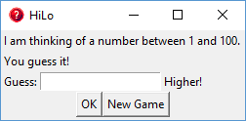

HiLo Example
Label
Label
Frame
Frame
Button
Button
Label
Label
Entry
Streams of bytes … two ways (into your program and out of your program)
Disks, consoles, sockets, keyboards, printers
Know how to talk streams and you can talk to anything
Initialization (constructor) is different. Use is the same.
Notes:
Let’s try a real example.
Here is the Hi/Lo game from before. I have the instructions at the top. Then the user’s guess entry. And the hint “HIGHER” or “LOWER” appears beside the guess when you press OK.
I changed the title and the icon up here. I’ll show you how to do that.
I also threw in a NEW GAME button.
How can we achieve this layout?
@1 These are easy. These are just labels taking up their entire row.
@2 Let’s make this area a separate frame.
@3 And the buttons will be on a separate frame.
@4 Here is the guess-input frame
@5 Labels on the left and right
@6 An Entry field in the middle.
@7 The frame with the buttons is easy – just the two buttons side by side.
How do we code this up?

Slide 16
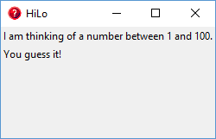
HiLo Example
root = tkinter.Tk()
root.title("HiLo")
root.iconbitmap("hilo.ico")
ins1 = tkinter.Label(root,text="I am thinking of a number between 1 and 100.", anchor=tkinter.W)
ins2 = tkinter.Label(root,text="You guess it!", anchor=tkinter.W)
ins1.pack(fill=tkinter.X)
ins2.pack(fill=tkinter.X)
Notes:
@1 This is how you change the title in the window. Just call “title” with the new text
@2 This is how you change the icon … call iconbitmap and pass in the name of the icon file
@2 Here are our labels packed in on rows at the top. I threw you a curve! Instead of putting the anchor in the pack, I passed it in the constructor! Use either way you like. Personally, I like it down here in the pack.

Slide 17
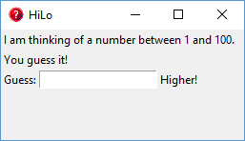
HiLo Example
ins1 = tkinter.Label(root,text="I am thinking of a number between 1 and 100.", anchor=tkinter.W)
ins2 = tkinter.Label(root,text="You guess it!", anchor=tkinter.W)
gb = tkinter.Frame(root)
lab = tkinter.Label(gb,text="Guess:")
inp = tkinter.Entry(gb)
hint = tkinter.Label(gb,text="Higher!");
ins1.pack(fill=tkinter.X)
ins2.pack(fill=tkinter.X)
lab.grid(row=0,column=0)
inp.grid(row=0,column=1)
hint.grid(row=0,column=2)
gb.pack(anchor=tkinter.W)
Notes:
Now for the User input frame.
@1 I’ll make a separate frame whose parent it the root (same as the earlier labels)
@2 Here is the label for guess, @3 the input entry, @4and the hint label
How do you want to organize the new widgets into a layout?
@5 How about a grid … one row and three columns. That’s one way. Maybe a PACK from the left? There are lots of ways to solve the problem
@6 And we pack the new frame into the outer frame … on a row below the instructions.
Why did I shuffle the code around? Why did I create the new widgets up here instead of down here with their layout management?
Either way works fine! I like to keep my “create widgets” code all together. And then my “layout widgets” code together after that. It’s just my preference. You do it the way you like. I just wanted to show you another idea.

Slide 18
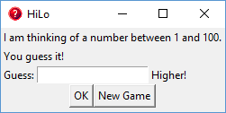
ins1 = tkinter.Label(root,text="I am thinking of a number between 1 and 100.", anchor=tkinter.W)
ins2 = tkinter.Label(root,text="You guess it!", anchor=tkinter.W)
gb = tkinter.Frame(root)
bp = tkinter.Frame(root)
lab = tkinter.Label(gb,text="Guess:")
inp = tkinter.Entry(gb)
hint = tkinter.Label(gb,text="Higher!");
bt1 = tkinter.Button(bp,text="OK")
bt2 = tkinter.Button(bp,text="New Game")
ins1.pack(fill=tkinter.X)
ins2.pack(fill=tkinter.X)
lab.grid(row=0,column=0)
inp.grid(row=0,column=1)
hint.grid(row=0,column=2)
bt1.pack(side=tkinter.LEFT)
bt2.pack()
gb.pack(anchor=tkinter.W)
bp.pack()
Notes:
And the buttons? @1 Lets create a frame for them named bp … “button panel”.
@2 I’ll create the button widgets up here with all the other widgets
Now for the layout
@3 pack the OK button on the left
@4 and the New Game button after that
@5 and add the button panel to the bottom of the main frame.
I said LEFT here. Why is OK way over here towards the middle?
Well, I said the LEFT side of the BP frame. This is the BP frame. I didn’t expand it or fill it, so it’s the minimum size to hold its widgets.
And I packed here with no arguments. That places the widget on a new row and the widget … in this case the frame … is centered on the new row.

Slide 19
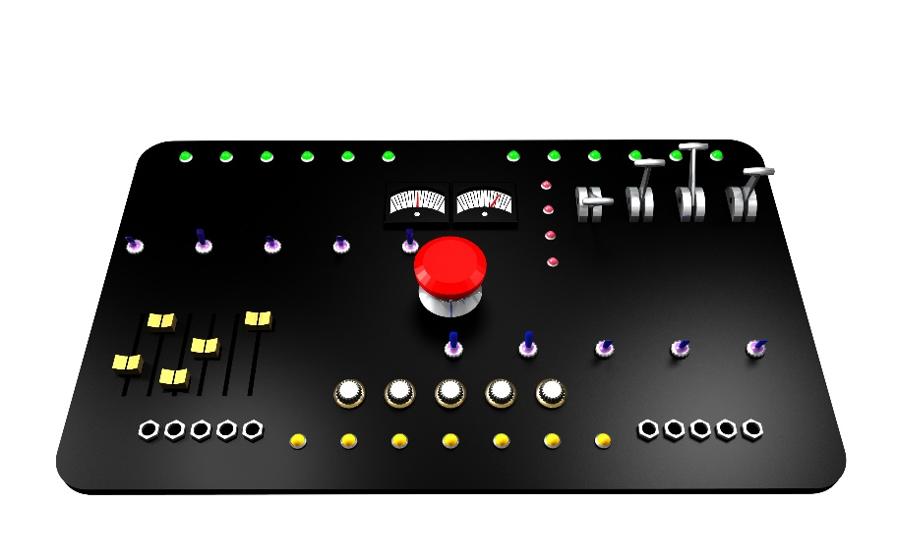
Tinkering
Type in the HiLo example
Improve the layout with some padding
Move the “new game” to a “file” menu
Add the game logic
Notes:
That’s quite a lot to absorb, I know. But really, you’ll learn the most from experimenting … tinkering.
Here are some optional exercises. There is nothing for you to send me.
Type in the hilo example from the past few slides. Experiment with the layout.
Improve the layout with some padding
Try moving the NEW GAME button to a file menu item
And try making the HiLo game functional! Add the game logic to the OK button.
Send me email if you have any questions or comments. See you next time.

